Slide 1
Joe Rants about Automation for 45 Minutes
Only Throw Soft Things.

Slide 2
Lessons Learned in Automation
SysAdmin to Architect to VMUG Leader/Author

Slide 3

HOWDY!
I’m Joe Houghes
- I am here as a user group leader
- I love to get people engaged & learning
Find me at @jhoughes or fullstackgeek.net

Slide 4
Background
Sr. Solutions Architect after ~20 years in IT
Co-leader - VMUG & PowerShell User Groups
Collector of communities
*Color* hat, big grin and the loud "Howdy Y'all."
Automate Yourself - Out of a (BASIC) IT Job
Perform higher-level tasks
Push yourself
Learn more
Don’t be afraid
Share your knowledge (Perspective)
Teach whatever you can (Be The Master)
Notes:
Currently a Senior Solutions Architect @ Pure Storage ( I leave the Senor for the bar)
Co-leader - VMUG & PowerShell User Groups since 2017 (Denver now, Austin previously)
Typically in code somewhere or a community presentation – now vExpert for 7 years and a Pro, Cisco Champion, Veeam Vanguard (finally), Tanzu Vanguard, and vBrownBag Crew
Colored hat, big grin and since I’m a native Texan you can understand the loud "Howdy Y'all."
Automation requires more in-depth thinking & focus
Result is then repeatable and consistent
Understand why we should do the easy tasks better
Jeff Snover – “No Technical Fellows of Cafeterias @ Microsoft”
Whose company makes more money or widgets based on your Exchange skills – Go O365
Push yourself to acquire new skills, always be willing to learn more about something that interests you
Keep technology fun & interesting - it can be a job, a hobby, and more importantly, an awesome career
Imposter syndrome is real – but push past it (or if you need very direct advice, get over it) and help out others
It is important to share your story and your journey, you may have learned something different, or explain something in a way that others can relate to
Sometimes it just takes the right perspective to understand a concept, and yours may be the perfect one for someone else
Teach whatever you can, don’t restrict this to IT or even technology
Plug for Don Jones & Be The Master – great book & workbook/planning methodology, even a great course – Just leave more than you took

Slide 5
Who’s in the audience?
Who in the room is an IT Pro? How about a Developer?
Who uses VSCode for their scripting/toolmaking? PowerShell ISE? A different IDE, like PowerShell Studio? Notepad?
Who uses source control for their code?
Who uses unit testing for their code?
Who is running code linting? Code validation? Full CI/CD pipelines?
How many PowerShell Experts are in the room?
We’re all learning, so be sure to write it down and share it with others.
Notes:
I'm not a PowerShell expert, I'm just a guy doing things and trying to help others, but I'd be glad to pick your brain

Slide 6
Why Are We Here?
STARTING
IN PROGRESS
ADVANCING
Notes:
Anyone in IT is always short of time, not tasks
Are you automating for the benefit of the business?

Slide 7
$89,526,124
185,244 tickets
100%
Cost savings to your company
Not coming through your helpdesk
Automation of everything!

Slide 8
45 minutes
For Joe to rant about code, well maybe 40 with Q&A.

Slide 9
Why Are We Here?
STARTING
IN PROGRESS
ADVANCING
Notes:
Anyone in IT is always short of time, not tasks
Are you automating for the benefit of the business?

Slide 10
Challenges Faced by Customers
SMB & SLED – Coverage, budget, time, training
Commercial – Coverage, budget, time, app lifecycle, infrastructure
FED – Auditing, compliance, time, access restriction
Enterprise – Scalability, repeatability, time, auditing
MSP – Scalability, repeatability, time, auditing, customer capability
*Anyone in IT is always short of time, not tasks*
Notes:
NOTE: This list is based off my own experience and the issues I have been asked to resolve in past consulting/partner/service provider roles, and since coming onboard to my current role working with all segments and customers of any size.
All verticals can have some differing issues or pain points which are most relevant to the business and IT department.
This is meant to display that some customers can face similar challenges, and in the end we are all short of time. It also helps put everyone in the mindset around why we should be making tools.

Slide 11
STARTING
Notes:
OK, on to Phase 1. Starting out.

Slide 12
START
WITH A PLAN
Notes:
How do we start?? We start with a plan. This is the same whether you are using the GUI or the CLI. Plan for success.
You need a plan for today, tomorrow and some point in the future, whether that is next week, next month, next quarter or next year. This is the same in talking about IT operations in any environment from SMB to Enterprise, maybe with just differing numbers of project managers involved.
Expect difficulties or failures, and be prepared to adjust your plan, but still PLAN FOR SUCCESS.
If this is not how you work, especially with code, CHANGE YOUR DEFAULTS.
For other lessons you may have already heard about this, we can fall back to the “6 Ps”, or the classic “Fail to plan, plan to fail.”

Slide 13
DEFINE
Goal
Benefits
Efficiencies
MVP
Notes:
As part of your plan, define it well and be explicit with facts, assumptions and minimum requirements.
Speed and performance are great, but they are an advantage to the org, not the true benefit of automation.
Think about the real benefit to the business, which is accuracy & repeatability. It’s not about impressing someone with your code. It’s not just about doing it fast but doing it correctly and being certain that it stays that way.
The goal of these efforts isn’t just about getting your operations into code, it is the benefits that you can gain from it: standardization, granular control, validation of configs, and testing for success.
We need to build & maintain tools in this fashion, and now our tools are mirroring our internal environment and operations.
This makes it easier to improve or even re-write even as we change platforms or technologies, which is what really matters to them in the long-term.
Try to be specific about steps/components and have an expectation before you start.
Don’t do more than is necessary to make minor changes, so that you can track those changes and results.
Then, make additional changes as necessary, but test and verify them along the way.
If we understand these concepts and work with our organizations to help them operate in this fashion, it enables us to be more valuable to the organization as enablers of the business, and they can more easily trust our capabilities.
Don't fear the changes as your company's needs grow, and we can have the ability to continue to provide value to the business, which leads to great things in your career.
Determine your MVP (minimum viable product)
Document requirements & assumptions
Define your process in small tasks
Avoid unnecessary functionality
Try to keep code simple & readable
Plan:
You need a plan for today, tomorrow and some point in the future, whether that is next quarter or next year. This is the same whether you are talking IT operations in any environment from SMB to Enterprise.
Plan for success, ALWAYS. Expect difficulties or failures, and be prepared to adjust your plan, but still plan for success.
As part of your plan, define it well and be explicit with facts, assumptions and minimum requirements. As you go through this plan, and your toolmaking process, validate those facts and assumptions. Revise or refine this plan as any needs or requirements change, or as new features are required.
If the overall script or tool won’t change due to original scoping, whether that's because of time/personnel resource or need for a working version, identify these new/revised requirements for the next features to add in a future version.
Be sure to understand what your user or customers are doing today, understand their needs, and work to enable more people to be capable of getting/delivering that need in a more efficient way. Your real value to an organization as a toolmaker is to enable as many people as possible to be capable of performing your job, with your knowledge (or restrictions), to move on to other places where you can be most effective for your organization.
Be specific about steps/components, and setting an expectation before you start. This requires that your can define needs, or at least minimums, to accomplish some task.
Speed & Performance:
Speed and performance are great for organizations trying to shift to new workflows and deployment cycles, but they are an advantage to the org, not the true benefit of automation.
The real benefit is in doing it correctly, having repeatable results, and being able to ensure that it remains correct over time.
In my opinion, this is the way that any organization should be thinking about their application stacks & workloads. Consider this same mindset for your tools & orchestration.
Standardization, validation and repeatability:
These are the benefits that you can gain from automation: standardization, validation of configs, and testing for success.
As customer shift more to Lean, Agile or DevOps methodologies, they care more about the configuration and control of an application or even a workload, and less about the wrapper that the app/workload lives within.
We need to build & maintain tools in this fashion, and now our tools are mirroring our internal environment and operations. This makes it easier to improve or even re-write even as we change platforms or technologies, which is what really matters to them in the long-term.
MVP - “Minimum viable product”:
I advise all people in technology to use small, incremental, or granular changes that can be verified.
You have to be able to define your progress, whether success or failure, to know if you have attained your goal; this should have also been defined at the beginning, and revised or refined along the way.
What I specifically give them for detail on this point is "Don’t do more than is necessary to make minor changes, so that you can track those changes and results. Make additional changes as necessary, but test and verify them along the way."
If we understand these concepts and work with our organizations to help them operate in this fashion, it enables us to be more valuable to the organization as enablers of the business, and they can more easily trust our capabilities. Don't fear change as your company's needs grow or change, and we have the ability to continue to provide value to the business, which leads to great things in your career.
Don’t expect to immediately automate your environment, or that you will have accounted for all of the necessary components at the beginning. Be flexible and prepare for change or improvements.
-------------------------------------------------
Software development philosophies: KISS, DRY, Worse is better, YAGNI, MVP
Keep It Simple Stupid – Simple over complicated
Don't Repeat Yourself - reducing repetition
Worse if Better - quality does not necessarily increase with functionality
You aren't gonna need it – define a need before adding function
Minimum viable product - sufficient features to satisfy early adopters; complete set of features designed/developed after considering feedback from product's users
Think specifically about what you need from your tool and what are you trying to solve?
Small tasks handles separately helps to maintain code
Keeps things easier to rear & maintain

Slide 14
BASICS
Help
RT(F)M
Pipeline
Stacking
Forget what you were told
Notes:
Follow the PowerShell way, even when building your own tool
Remember what we learned about the PowerShell basics, look at the help files. If you are still stuck or need more help, check out the examples and online documentation. Other people are also normally glad to save you some pain in your journey.
The pipeline concept is simple: first, get an object, then work with it. Once you learn how to leverage the pipeline to connect cmdlets together, you will see how quickly you can achieve massive results with PowerShell.
Seriously, get some Legos to practice. The new sets can be a complex final product with many distinct steps to get you to that final product. This is why you should have an expected result at the start, then specific steps to achieve that result.
Believe it or not, you can even cheat from yourself. If you are trying to learn the code or find a specific setting, create or change it in the GUI and then pull it up in PowerShell to find how it was done.
You can teach this to yourself if you just put in the effort, and you can always ask for help if you get stuck. Focus on the result, it is only important that you attain the goal or desired result.
The path to get there doesn’t matter to the business as long as you achieve success.

Slide 15
AUTOMATION BASICS
GET
All or some
Structure
Reports
Start with 1 task
Modular Code
Notes:
Follow the PowerShell way, even when building your own tool
Remember what we learned about the PowerShell basics, look at the help files. If you are still stuck or need more help, check out the examples and online documentation. Other people are also normally glad to save you some pain in your journey.
The pipeline concept is simple: first, get an object, then work with it. Once you learn how to leverage the pipeline to connect cmdlets together, you will see how quickly you can achieve massive results with PowerShell.
Seriously, get some Legos to practice. The new sets can be a complex final product with many distinct steps to get you to that final product. This is why you should have an expected result at the start, then specific steps to achieve that result.
Believe it or not, you can even cheat from yourself. If you are trying to learn the code or find a specific setting, create or change it in the GUI and then pull it up in PowerShell to find how it was done.
You can teach this to yourself if you just put in the effort, and you can always ask for help if you get stuck. Focus on the result, it is only important that you attain the goal or desired result.
The path to get there doesn’t matter to the business as long as you achieve success.

Slide 16
IN PROGRESS

Slide 17
PROCESS
1
3
5
2
4
6
Notes:
Your automation is your roadmap to your goal.
Remember that one that we defined earlier? This is how we get there.

Slide 18
ROADMAP
Notes:
Delivery methods
Are you using the right medium?
Are you explaining your concept in simple or easy to follow terms? (Avoid acronym soup)
Are people in your audience visual or auditory learners?
Even for auditory learners, images can make abstract concepts easier to follow

Slide 19
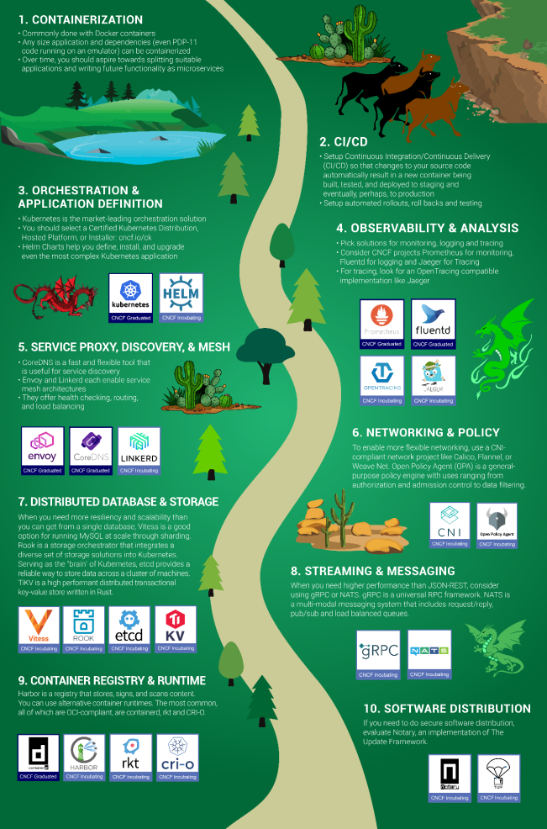
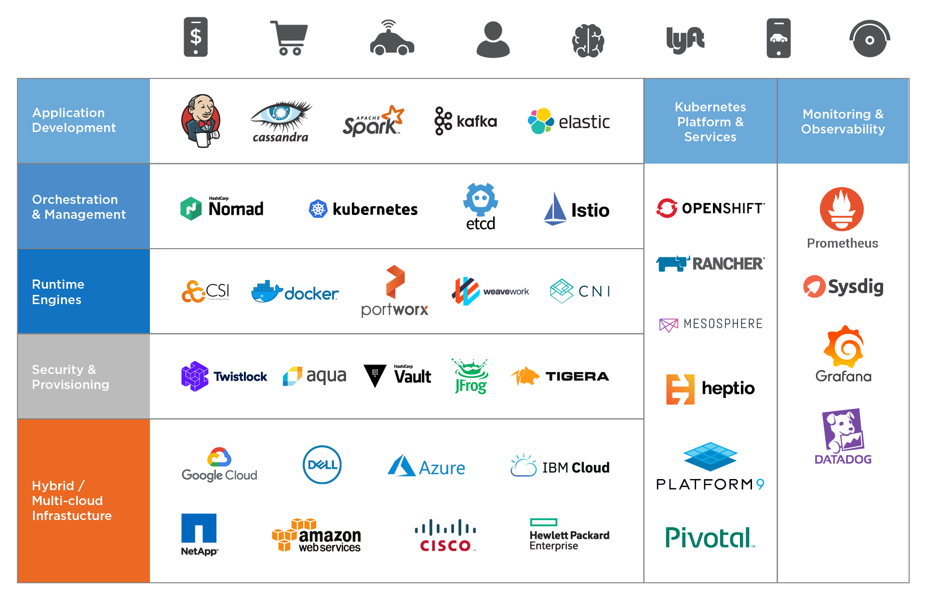
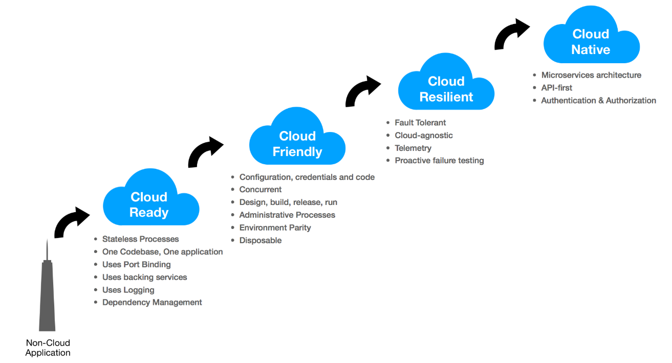
Tell a Story
Notes:
Do this with your visual presentation:
Don’t start with the eye charts
Walk through your concept slowly
Periodically ensure that people are following with your walk through

Slide 20
MEASURE
4000
3000
2000
1000
0
Notes:
Honestly, I can’t tell you what you should measure, which is why this graph has no labels across it.
I’m sure that I caught a few of you in the audience scanning that information to see what it is, and what specific metrics I put on a slide here.
Well, it’s not that easy. Or in consultant speak, it depends.
Honestly, what you are measuring can encompass everything from

Slide 21
Learn You Some Business
Speak to your Audience in THEIR terms
Know what is important to your business
Is IT / technology really your business?
Technical Fellow of Cafeterias
PRO TIP:
Your job belongs to your employer
Your career belongs to YOU
Notes:
HINT: It's your job, but it's probably not the business

Slide 22
AUTOMATION IMPROVEMENTS
Filter Left
Get out of your code
Learned it in math
Automated checks
Software dev methods
Notes:
Follow the PowerShell way, even when building your own tool
Remember what we learned about the PowerShell basics, look at the help files. If you are still stuck or need more help, check out the examples and online documentation. Other people are also normally glad to save you some pain in your journey.
The pipeline concept is simple: first, get an object, then work with it. Once you learn how to leverage the pipeline to connect cmdlets together, you will see how quickly you can achieve massive results with PowerShell.
Seriously, get some Legos to practice. The new sets can be a complex final product with many distinct steps to get you to that final product. This is why you should have an expected result at the start, then specific steps to achieve that result.
Believe it or not, you can even cheat from yourself. If you are trying to learn the code or find a specific setting, create or change it in the GUI and then pull it up in PowerShell to find how it was done.
You can teach this to yourself if you just put in the effort, and you can always ask for help if you get stuck. Focus on the result, it is only important that you attain the goal or desired result.
The path to get there doesn’t matter to the business as long as you achieve success.

Slide 23
ADVANCING

Slide 24
IMPROVEMENTS
AWARENESS
DISCOVERY
EVALUATION
INTENT
GUIDELINES
CODE

Slide 25
ADVANCED AUTOMATION
Idempotent vs Declarative
Right tool for the right job
Not just code
Learn from Others
+ Docs
Share your Experience
Notes:
Follow the PowerShell way, even when building your own tool
Remember what we learned about the PowerShell basics, look at the help files. If you are still stuck or need more help, check out the examples and online documentation. Other people are also normally glad to save you some pain in your journey.
The pipeline concept is simple: first, get an object, then work with it. Once you learn how to leverage the pipeline to connect cmdlets together, you will see how quickly you can achieve massive results with PowerShell.
Seriously, get some Legos to practice. The new sets can be a complex final product with many distinct steps to get you to that final product. This is why you should have an expected result at the start, then specific steps to achieve that result.
Believe it or not, you can even cheat from yourself. If you are trying to learn the code or find a specific setting, create or change it in the GUI and then pull it up in PowerShell to find how it was done.
You can teach this to yourself if you just put in the effort, and you can always ask for help if you get stuck. Focus on the result, it is only important that you attain the goal or desired result.
The path to get there doesn’t matter to the business as long as you achieve success.

Slide 26
THANKS!
Any questions?
Find me at @jhoughes or fullstackgeek.net

Slide 27
CREDITS
Special thanks to all the people who made and released these awesome resources for free:
Presentation template by SlidesCarnival
Photographs by Unsplash

Slide 28
TIMELINE
Blue is the colour of the clear sky and the deep sea
Red is the colour of danger and courage
Black is the color of ebony and of outer space
Yellow is the color of gold, butter and ripe lemons
White is the color of milk and fresh snow
Blue is the colour of the clear sky and the deep sea
JAN
FEB
MAR
APR
MAY
JUN
JUL
AUG
SEP
OCT
NOV
DEC
Yellow is the color of gold, butter and ripe lemons
White is the color of milk and fresh snow
Blue is the colour of the clear sky and the deep sea
Red is the colour of danger and courage
Black is the color of ebony and of outer space
Yellow is the color of gold, butter and ripe lemons

Slide 29
SWOT ANALYSIS
STRENGTHS
Blue is the colour of the clear sky and the deep sea
WEAKNESSES
Yellow is the color of gold, butter and ripe lemons
S
W
Black is the color of ebony and of outer space
OPPORTUNITIES
White is the color of milk and fresh snow
THREATS
O
T

